Slide 1
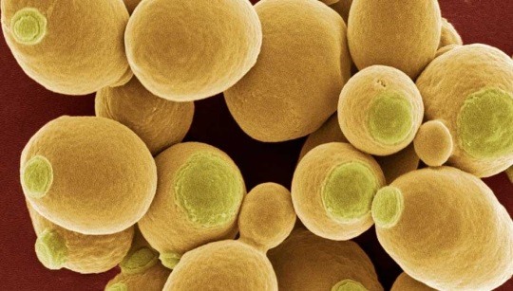
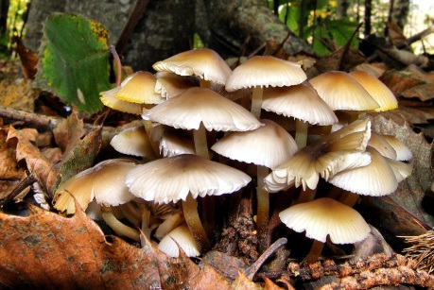
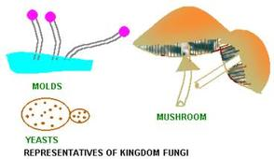
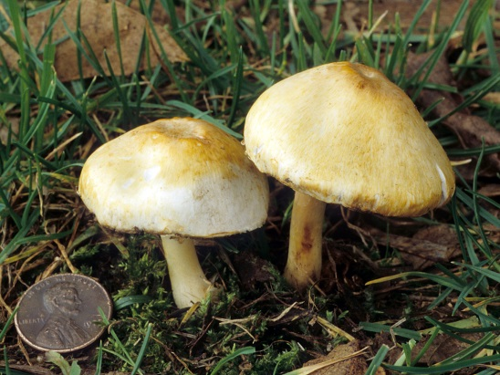
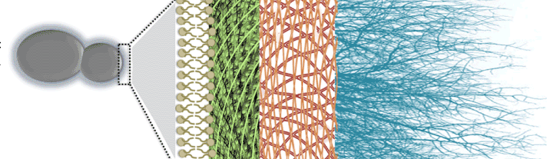
Kingdom FUNGI
These are heterotopic eukaryotic organisms
They use decaying organic material as food and are therefore called saprophytes
sapros = dead, decaying
Many of them have the capacity to become multicellular organism at certain stages in their lives
They have cell-walls made of a tough complex sugar called chitin
Examples are yeast and mushrooms
Chitin

Slide 2
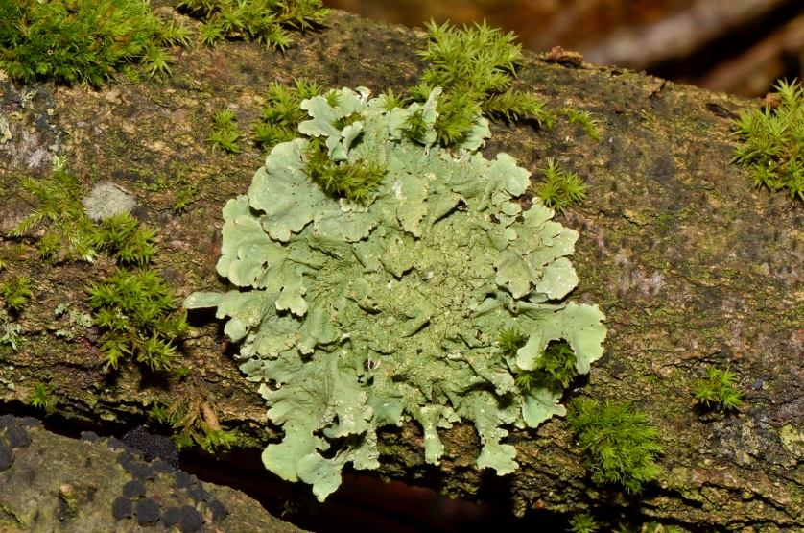
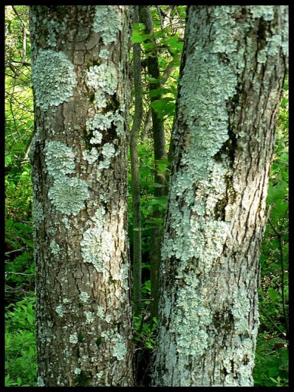
Kingdom FUNGI
Some fungal species live in permanent mutually dependent relationships with bluegreen algae (or cyanobacteria).
Such relationships are called symbiosis.
These symbiotic life forms are called lichens.
Sym = association
Biosis = living together
We have all seen lichens as the slow-growing large coloured patches on the bark of trees.

